Slide 1

TADs are 3D structural units of higher-order chromosome organization in Drosophila
Quentin Szabo, Daniel Jost, Jia-Ming Chang,* Diego I. Cattoni,Giorgio L. Papadopoulos, Boyan Bonev, Tom Sexton, Julian Gurgo, Caroline Jacquier, Marcelo Nollmann, Frédéric Bantignies, Giacomo Cavalli
Team members :
劉育佑 111753145
翁佑祥 111753226
張禎尹 111753136
周庭威 111753223
Notes:
TADs=TEDs
Chromosome = chrome 松
Drosophila = draw so f la

Slide 2
01. Paper Introduction
02. Inputs
CONTENTS
03. Packages
04. Results
05. Reproducibility
Notes:
Reproducibility = re produce bility

Slide 3

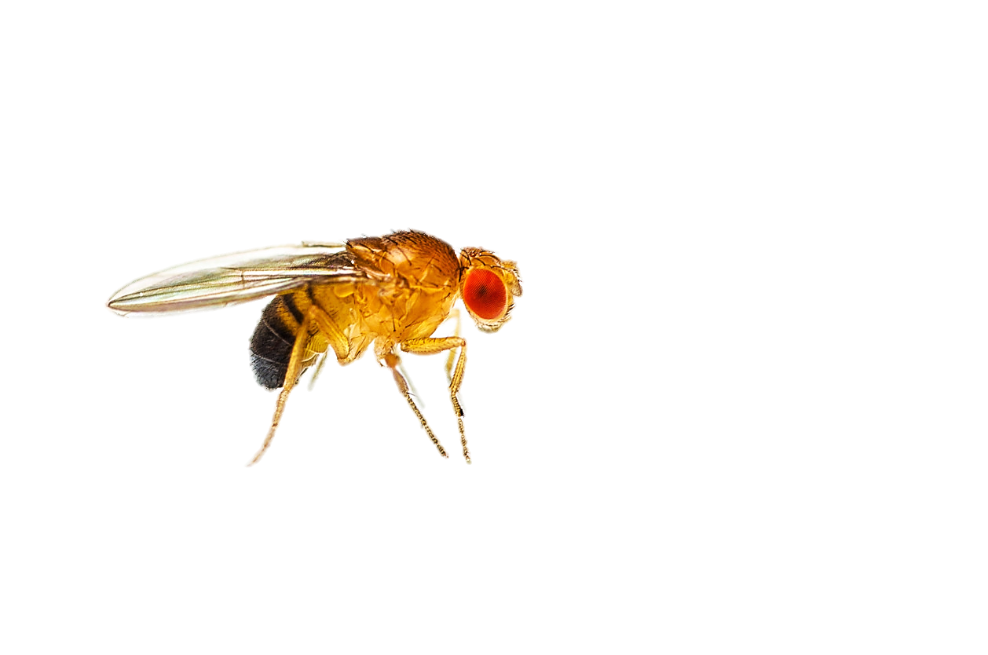
Paper Introduction

Slide 4
Paper Introduction
The study goal to understand the rules of genome folding in the cell nucleus, which is essential for understanding its functions.
The study uses chromosome conformation capture (Hi-C) to reveal that the genome is partitioned into topologically associating domains (TADs).
TADs are considered to be fundamental units of the three-dimensional (3D) organization of the genome
Notes:
we want to know the rules of genome folding in the cell nucleus ,so we use chromosome conformation capture (Hi-C) in this paper.
TADs are considered to be fundamental units of the three-dimensional (3D) organization of the genome, and the TADs boundaries play a role in regulating gene expression by restricting interactions of cis-regulatory sequences to specific target genes. TADs and TAD boundaries have been implicated in the pathogenesis of rare diseases.

Slide 5
Paper Introduction
The correlation of TAD structures with epigenetic marks can be observed in mammals using high-resolution Hi-C maps.
HI-C can reveal the TADs, this information can provide insights into the regulation of gene expression, and has potential implications for understanding disease development.
Notes:
Than why is HI-C
使用高分辨率 Hi-C 圖可以在哺乳動物中觀察到 TAD 結構與表觀遺傳標記的相關性。
By identifying regions of the genome that interact more frequently with each other than with other regions, HI-C can reveal the TADs, which are regions of highly interacting chromatin, with reduced interactions between them. This information can provide insights into the regulation of gene expression, and has potential implications for understanding disease development.

Slide 6
Paper Introduction
This article mainly uses the variant of HI-C called “ In situ Hi-C ”
In situ Hi-C uses ligation performed in intact nuclei rather than in solution, decreases the frequency of random, biologically irrelevant contacts and ligations.
Use less time-consuming and requires less cells than standard Hi-C and can achieve higher resolution.
Notes:
In this article mainly uses the variant of HI-C called “ In situ Hi-C ”. in situ HI-C decreases the frequency of random, biologically irrelevant(=a re the vant) contacts and ligations(=lie ga tion). Use less time-consuming and requires less cells than standard Hi-C and can achieve higher resolution.
However, it also has the potential for capturing non-accurate interactions due to the densely(=den se ly) packed nature of nuclei and requires a high sequencing depth.

Slide 7
Paper Introduction
Cell culture, FACS sort, crosslink
Flash freeze in liquid N₂
Lysis
Mbol digest, fill overhangs, biotin mark
DNA ends, ligate, reverse crosslink
The basic steps of the protocol include:
DNA extraction
Shear
Size select
Biotin pulldown, end repair,
adapter ligation
PCR ampitication
PCR cleanup
Quantification, quality control, sequencing
Notes:
HBased on thei-C protocol's basic steps of the protocol, last quantifying and assessing the quality of the DNA samples and sequencing the captured interactions. These series of steps allow the researchers to understand the interactions between d different regions of the genome in 3D. Based on the

Slide 8
Input

Slide 9
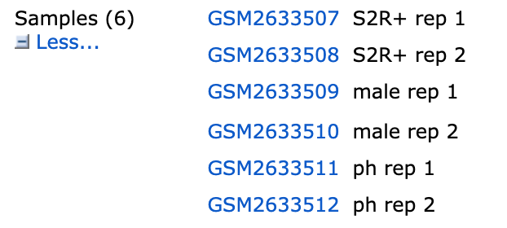
Inputs
(Drosophila/Fruit Fly)
Sequencing Data :
Download from NCBI GSE99107
6 samples
SRA file total size :186.28GB
FASTQ total size : about 1TB
Reference Data : (23.8MB) https://www.ncbi.nlm.nih.gov/genome/gdv/browser/genome/?chr=2L&id=GCF_000001215.4

Slide 10
Input Data Download
SRA Toolkit : fastq-dump SRAXXXXXX
--gz : smaller file,but longer download time
--split : split file
fasterq-dump: someone said it’s faster.

Slide 11
Package

Slide 12
Package : Hi-C Pro
Install
Edit Config
Edit Config
Python2.7
hicpro
samtools
bowtie2
R
pysam
bx-python
numpy
scipy
ggplot2(R)
RColorBrewer(R)
Config-install.txt
Config-hicpro.txt
HiC-Pro -c config-hicpro.txt -i [rawdataPath] -o [Output File Path]

Slide 13
Hi-C Pro - Download & Install
#HiC-Pro Download
git clone https://github.com/nservant/HiC-Pro.git
#Other Packages:
conda create -n hicpro python2.7
source activate hicpro
conda install -y samtools bowtie2 R
conda install -y pysam bx-python numpy scipy
#Open R
install.packages(c('ggplot2','RColorBrewer'))

Slide 14
Hi-C Pro - Edit Config
Config-install.txt
PREFIX = [HiC Pro Document Directory]
BOWTIE2_PATH = [bowtie2 install Directory]
SAMTOOLS_PATH = [samtools install Directory]
R_PATH = [R install Directory]
PYTHON_PATH = [python install Directory]
CLUSTER_SYS = one of TORQUE,SGE,SLURM,LSF
Config-install.txt
BOWTIE2_IDX_PATH = # bowtie2index directory，can download or build by bowtie2-build
REFERENCE_GENOME = # bowtie2 index file name
GENOME_SIZE = # Genome size file,can download from http://hgdownload.cse.ucsc.edu/goldenPath/
GENOME_FRAGMENT = # bed file，under the annotation folder
LIGATION_SITE = # Sequence after rejoining of restriction sites
PAIR2_EXT = [SRA file name]

Slide 15
HiCExplorer
HiCExplorer — HiCExplorer 3.7.2 documentation

Slide 16
HiCExplorer-environment
WSL(Windows Subsystem for Linux)
Miniconda
HiCExplorer requirement:(bioconda, conda-forge)
python >= 3.6 numpy >= 1.19.* scipy >= 1.5.* matplotlib-base >= 3.1.* ipykernel >= 5.3.0 pysam >= 0.16.* intervaltree >= 3.1.* biopython pytables >= 3.6.* pandas >= 1.1.* pybigwig >= 0.3.* jinja2 >= 2.11 unidecode >= 1.1.* hicmatrix >= 15 hic2cool >= 0.8.3 psutil >= 5.7.* pygenometracks >= 3.5 fit_nbinom >= 1.1 cooler >= 0.8.10 krbalancing >= 0.0.5 pybedtools >= 0.8.* future >= 0.18 tqdm >= 4.50 hyperopt >= 0.2.4 python-graphviz >= 0.14

Slide 17
HiCExplorer-sequence alignment needed
BWA(Burrows-Wheeler Aligner)
samtools
bbmap(from bioconda)

Slide 18
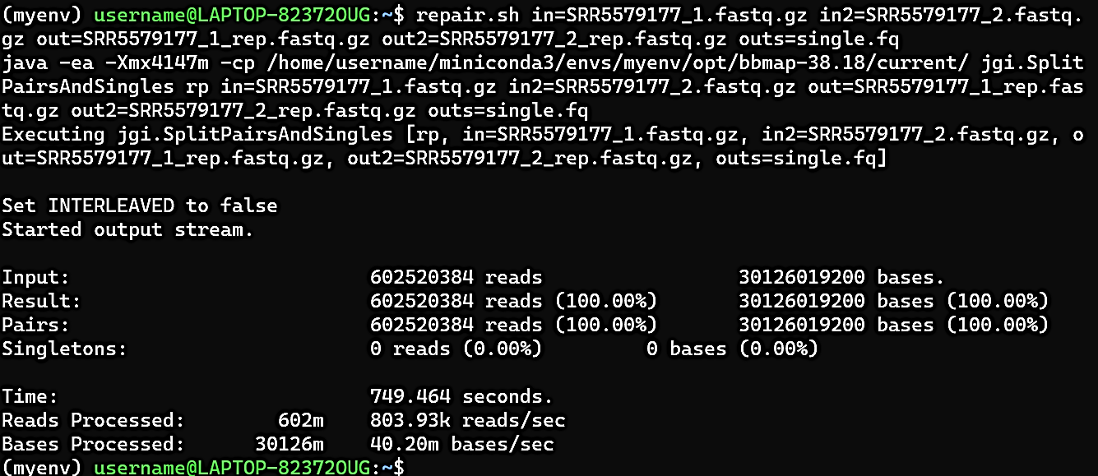
HiCExplorer-sequence alignment needed
602millions reads and 30billions bases

Slide 19
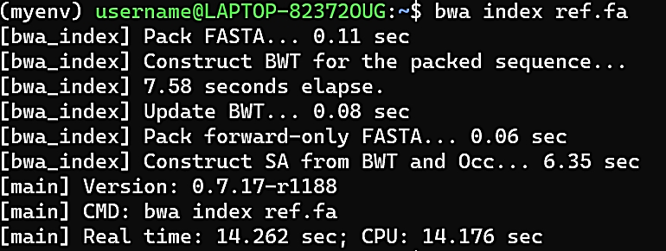
HiCExplorer-sequence alignment needed
The most important step

Slide 20
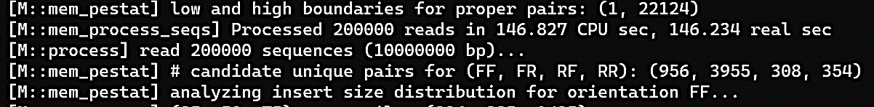
HiCExplorer-sequence alignment needed
##build sub sam(not finish)
$ bwa mem ref/ref.fa SRR5579177_1_rep.fastq.gz SRR5579177_2_rep.fastq.gz > alignment/SRR5579177.sam
600 millions / 200 thousands = 3,000
2.5minute * 3,000 = 125hr = 5days…

Slide 21
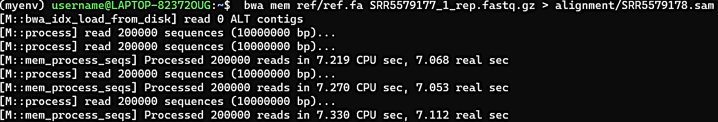
HiCExplorer-sequence alignment needed
Build separate sam
600 millions / 200 thousands = 3,000
7sec * 3,000 = 350mins = 5.83 hrs

Slide 22
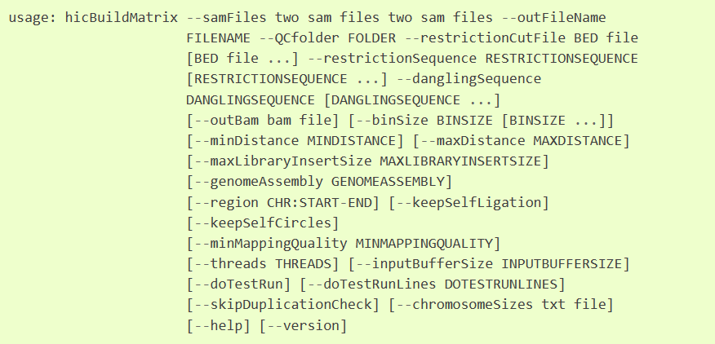
HiCExplorer-sequence alignment needed
Buildmatrix-(not finish)

Slide 23
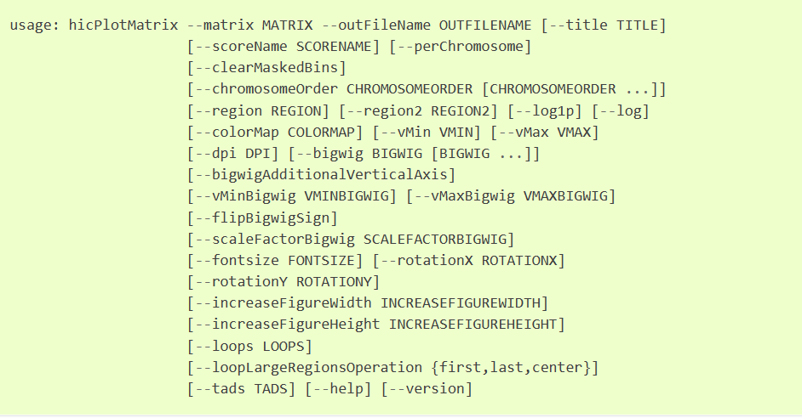
HiCExplorer-sequence alignment needed
PlotMatrix(heat map)

Slide 24
Juicer

Slide 25
Package : Juicer
Install
Process File
Run
Juicer
BWA
Java
Reference Genome index (BWA)
restriction sites information
Visualization
JuiceBox

Slide 26
Juicer
Juicer-Install
git clone https://github.com/theaidenlab/juicer.git
ln -s juicer/CPU scripts
cd scripts/common
wget http://hicfiles.tc4ga.com.s3.amazonaws.com/public/juicer/juicer_tools.1.7.6_jcuda.0.8.jar
ln -s juicer_tools.1.7.6_jcuda.0.8.jar juicer_tools.jar
cd ../..

Slide 27
Juicer
Juicer-Process File
Reference Genome Index : bwa index file_name.fasta (took very long time)
Construct restriction site text file : python2
../juicer/misc/generate_site_positions.py MboI hg38_MboI
../references/Homo_sapiens_assembly38.fasta
awk 'BEGIN{OFS="\t"}{print $1, $NF}' hg38_MboI.txt > hg38.chrom.sizes

Slide 28
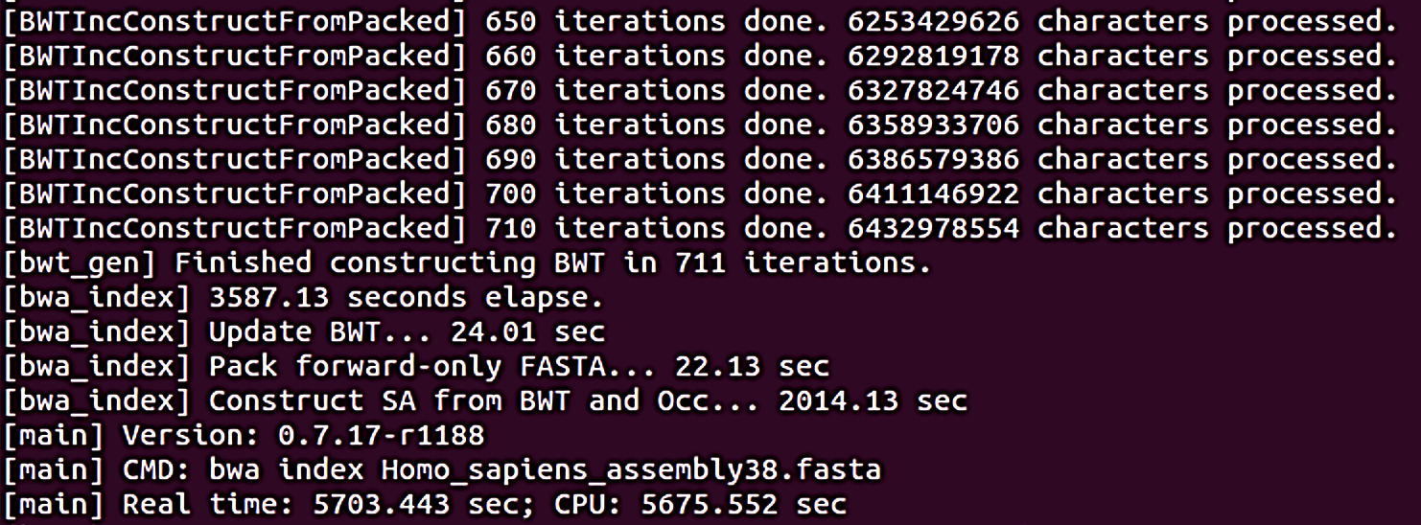
Juicer

Slide 29
Juicer
Juicer-Run
bash scripts/juicer.sh -d <path/opt> \ #Sample FASTA directory
-D <path/opt> \ #Software install directory
-y restriction_sites/hg38_MboI.txt \
-z references/Homo_sapiens_assembly38.fasta \
-p restriction_sites/hg38.chrom.sizes \
-s MboI

Slide 30
Juicer
Juicer-Run
bash /home/parallels/Desktop/juicer/juicer/CPU/juicer.sh -d /home/parallels/Desktop/juicer/work2 -D /home/parallels/Desktop/juicer -y /home/parallels/Desktop/juicer/restriction_sites/hg38_MboI_MboI.txt -z /home/parallels/Desktop/juicer/references/Homo_sapiens_assembly38.fasta -p /home/parallels/Desktop/juicer/restriction_sites/hg38.chrom.sizes -s MboI > log_0536.txt

Slide 31
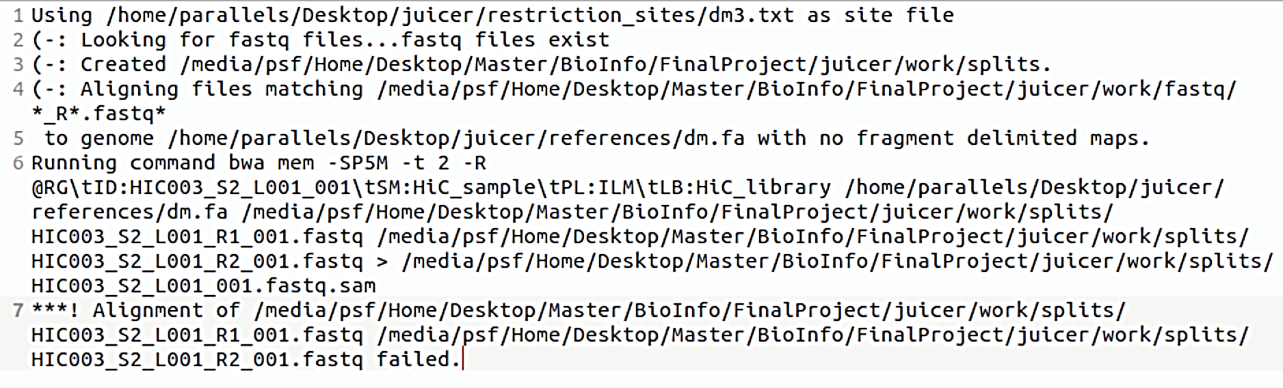
Juicer
Juicer Result

Slide 32
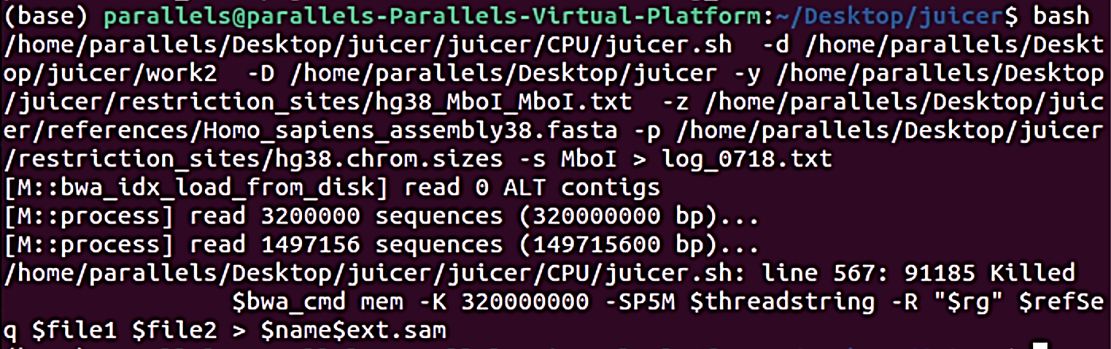
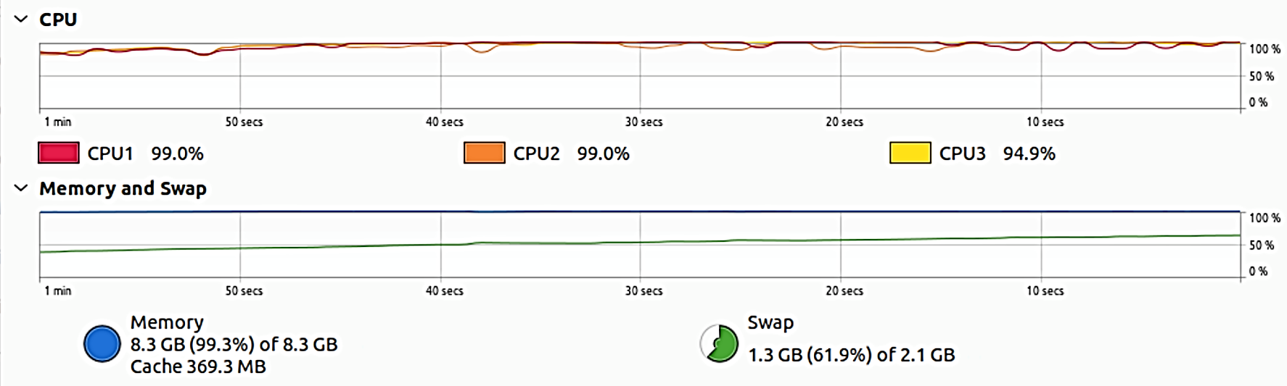
Juicer

Slide 33
Corporate
Corporate
Data download and Juice operation 劉育佑
HI-C explore operation 翁佑祥
paper and related methods Introduction 張禎尹
paper comprehension reading 周廷威

Slide 34
Thank you for listening
Team members :
劉育佑 111753145
翁佑祥 111753226
張禎尹 111753136
周庭威 111753223
Notes:
TADs=TEDs
Chromosome = chrome 松
Drosophila = draw so f la

